Slide 1

Unveiling the Data Job Market
Chloe and Jacob

Slide 2
Table of contents
Introduction
Methodology
Job Postings Analysis
Predictive modelling for job prospects
Key findings
Conclusions and Next Steps

Slide 3
Introduction
Motivation:
Increasing demand for skilled professionals in data-centric roles.
Lack of information regarding requirements and what a good prospect looks like within this domain.
Objectives:
To identify prevalent job titles, skill requirements, and industry trends.
Ensure educators are developing courses or workshops tailored to meet the current industry demands for knowledge and skills,.

Slide 4
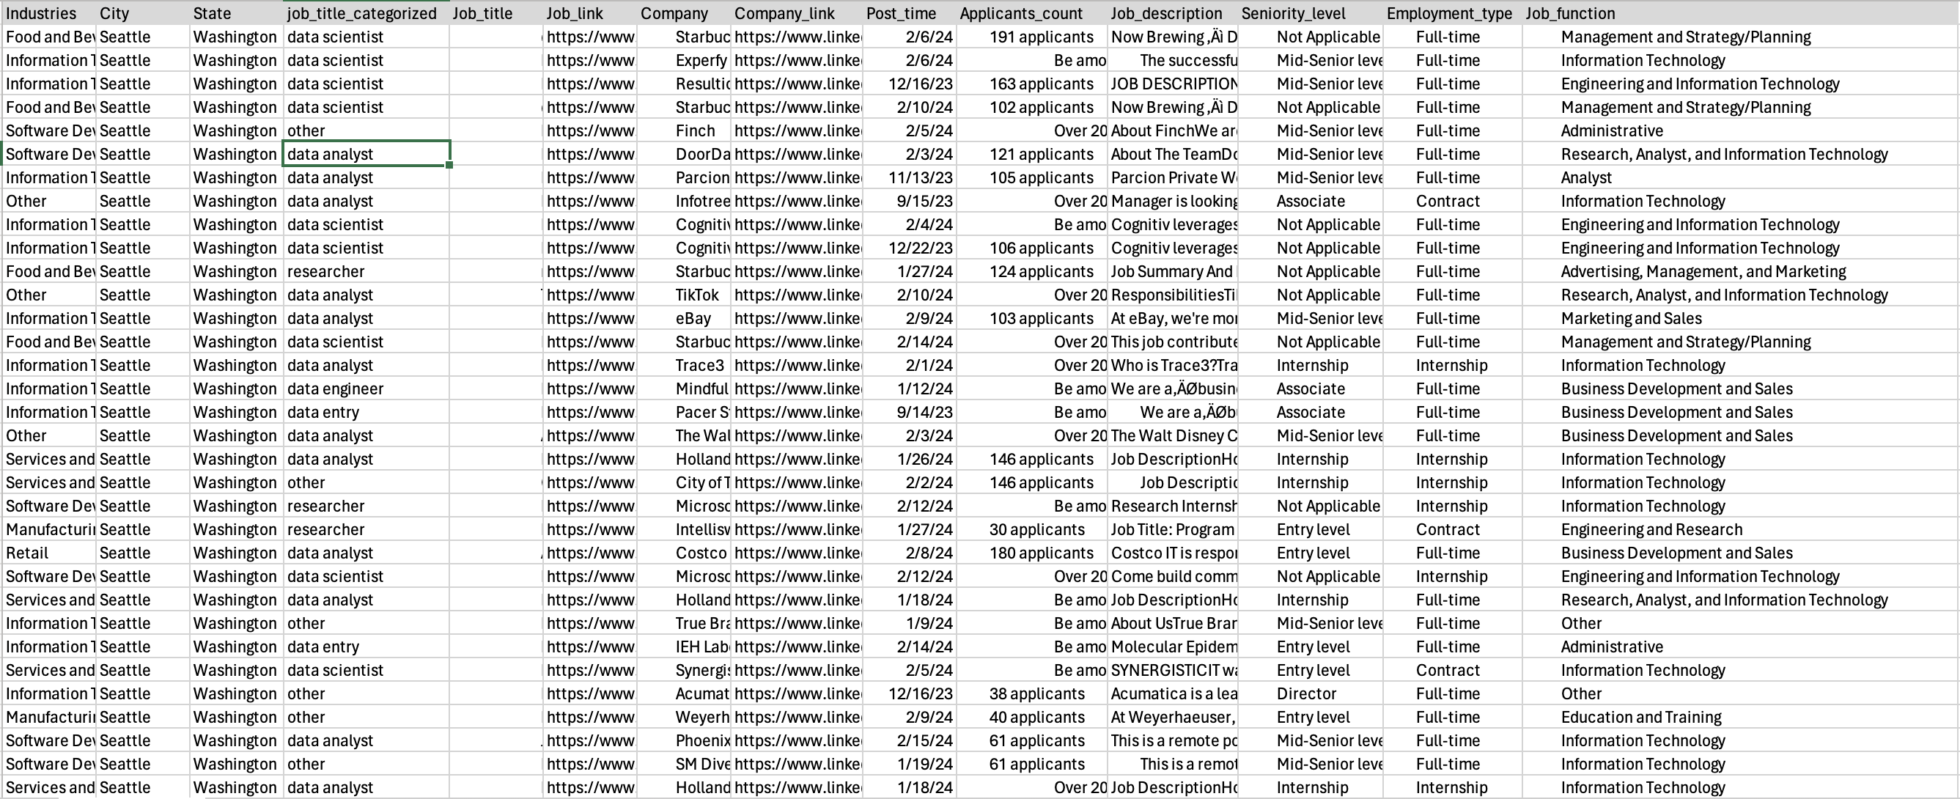
Job Posting Dataset

Slide 5
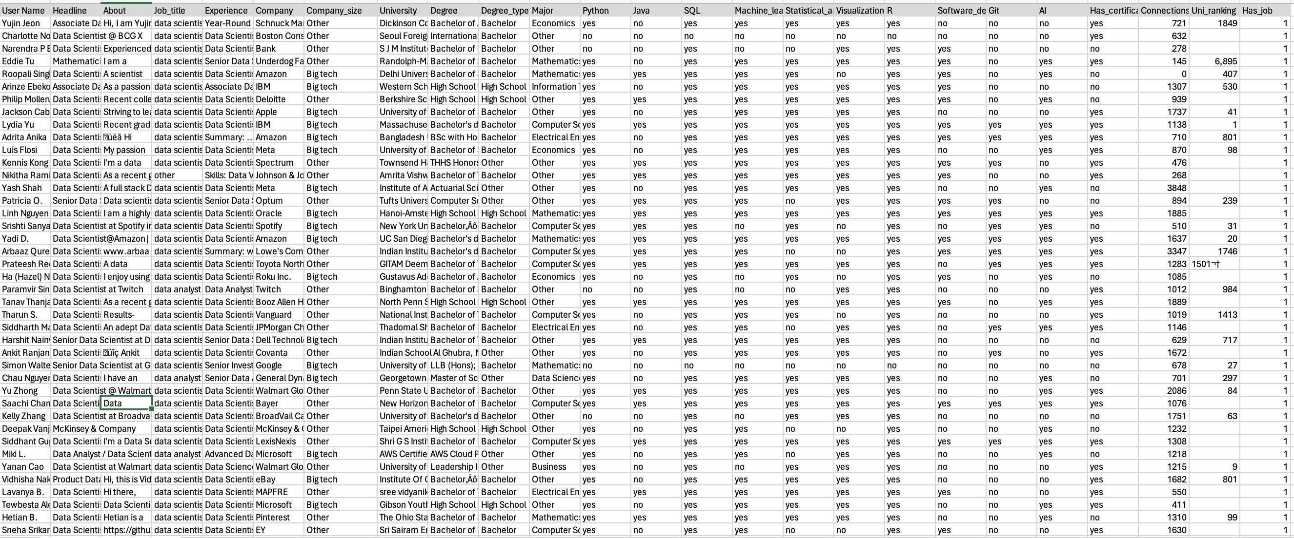
Profile Dataset

Slide 6
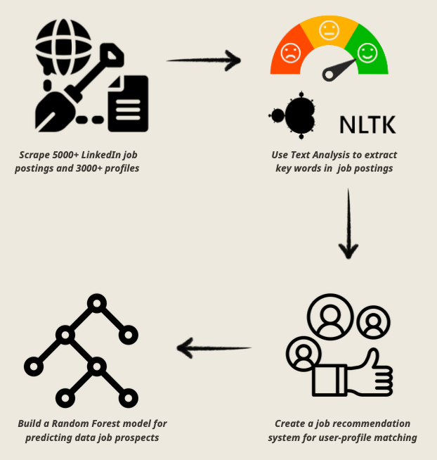
2. Methodology
To gain insights into the factors influencing the likelihood of securing a data job, we conducted two analyses:
1) Extracting key skills and tools required across various data job postings using NLP
2) Conducting predictive modeling to assess job landing prospects based on educational background and specific skills.

Slide 7
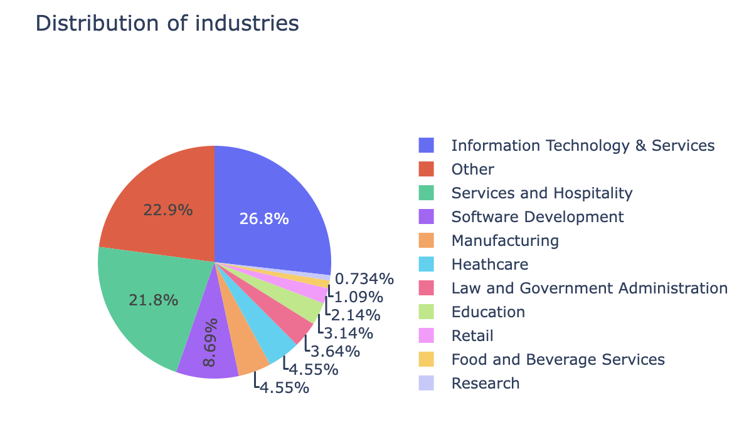
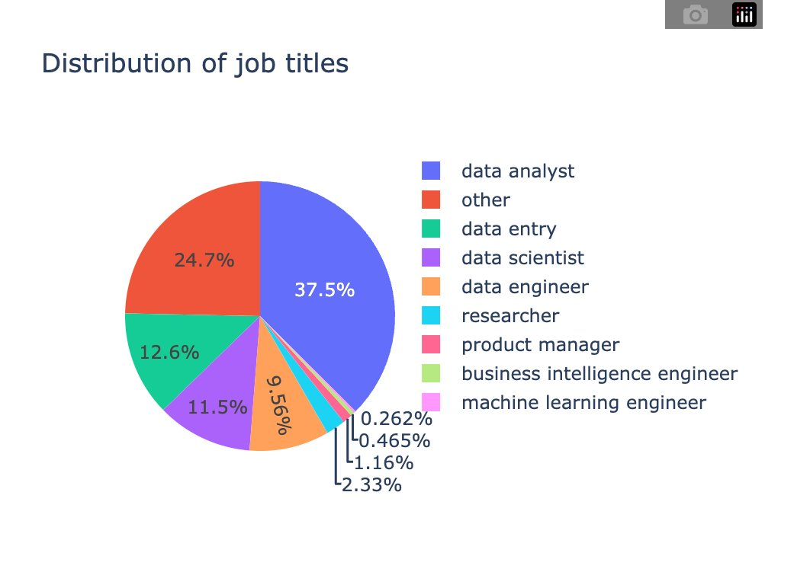
3. Job Postings Analysis

Slide 8
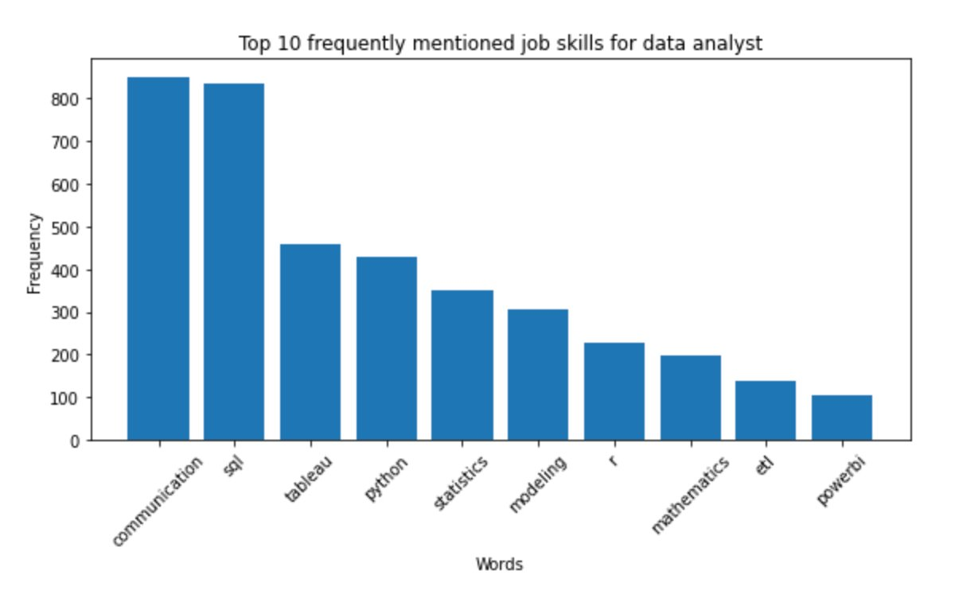
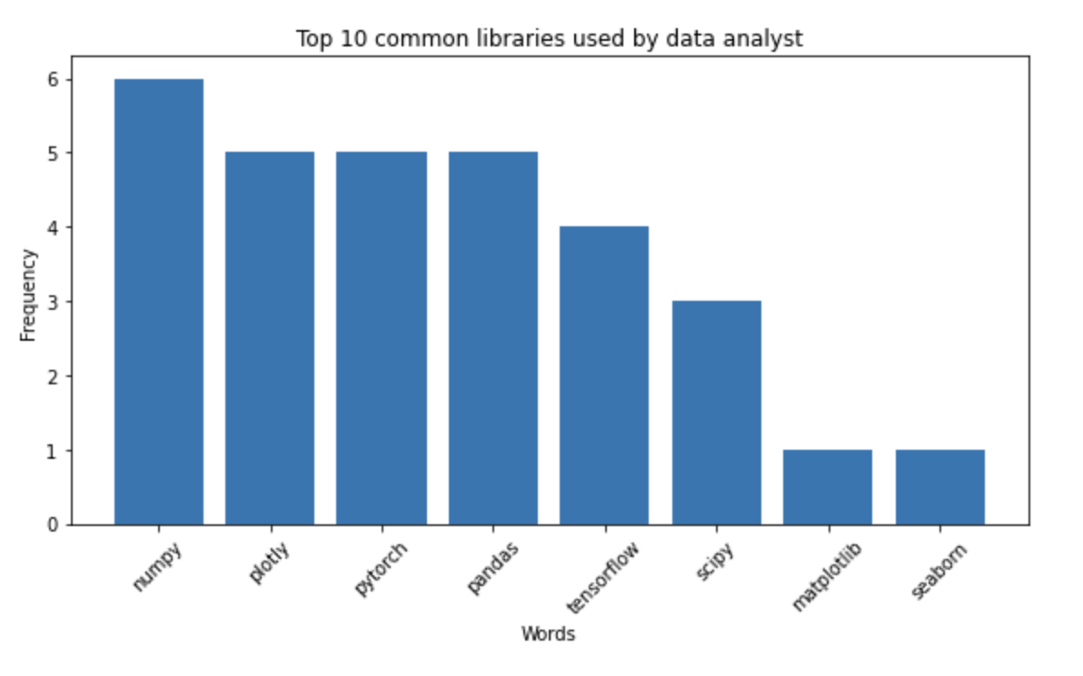
3. Job Postings Analysis

Slide 9
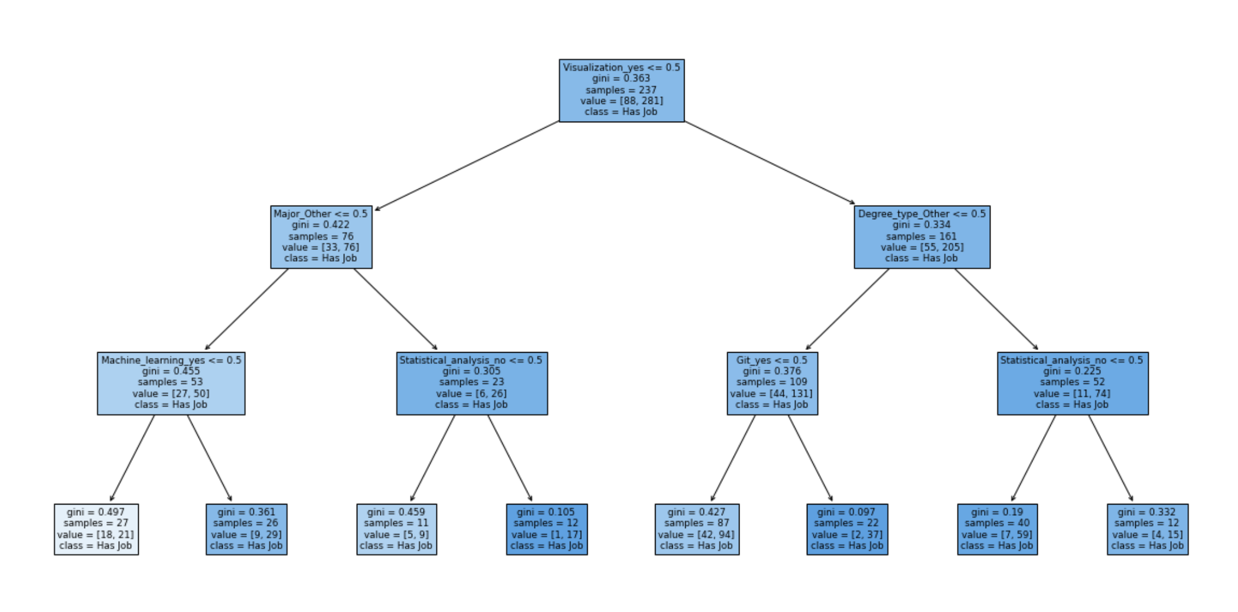
4. Predictive Modeling
Using random forest

Slide 10
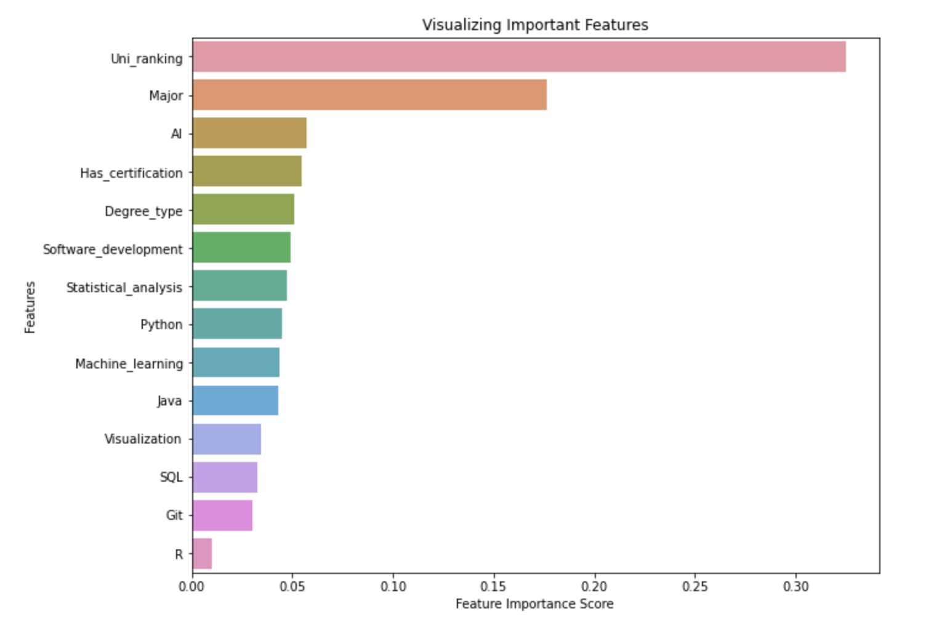
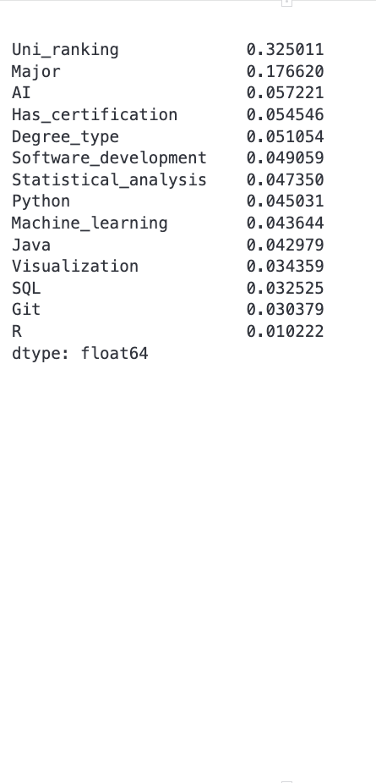
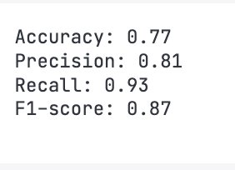

Slide 11
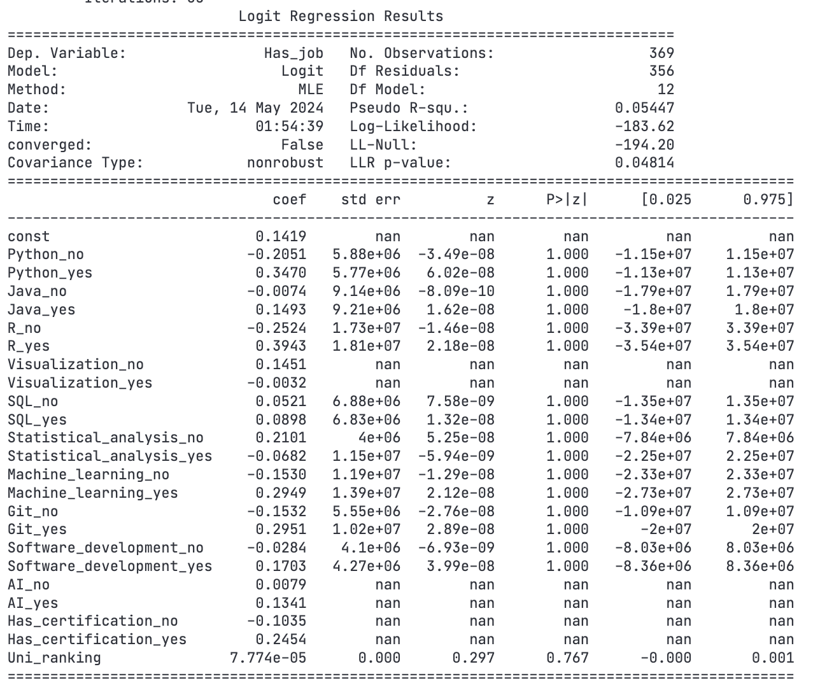
b) Understanding the relationship between university raking and job prospects

Slide 12
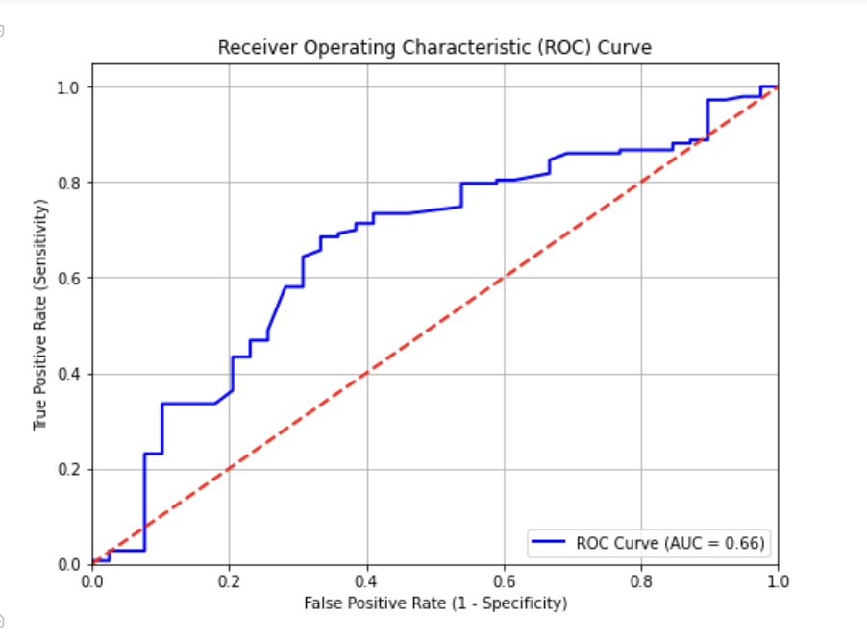
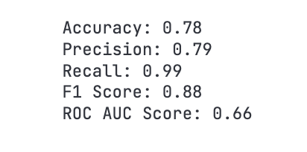
b) Understanding the relationship between university raking and job prospects

Slide 13
5. Key Findings
Data analysts are in the highest demand, comprising 50% of the market, followed by data entry roles and data scientists.
The industries with the greatest demand for data roles include Information Technology & Services, followed by Services & Hospitality, and Software Development. Education and Retail sectors also show a notable interest in hiring for data roles, albeit to a lesser extent.
Communication, SQL, visualization skills, and Python are the most demanded skills for data analysts. Additionally, they frequently utilize NumPy, Plotly, and Pandas in their daily tasks.
University ranking can influence job opportunities. Also, proficiency in machine learning and AI can set a candidate apart, enhancing their prospects of securing a data-related position.

Slide 14
6. Implications
Stakeholders
Ethical, Legal, and Societal
- Students can focus their efforts on acquiring the most in-demand skills and knowledge identified through the scraped data, increasing their competitiveness in the job market.
- Employers benefit from a pool of candidates with skills and experiences closely aligned with their needs for data positions, streamlining the recruitment process.
Ethical – Scraping data with personal information always comes with ethical considerations, however in the results we ended up taking out any personal information
Legal – Adhering to LinkedIn's terms of service and policies regarding data scraping is crucial to avoid potential legal consequences or violations.
Societal – Potential for worsened inequality in the job market if certain groups are underrepresented or disadvantaged in the data scraped from LinkedIn.

